Slide 1
Discrete Mathematics number of T-Routes, parenthesization
Liangfeng Zhang
School of Information Science and Technology
ShanghaiTech University

Slide 2
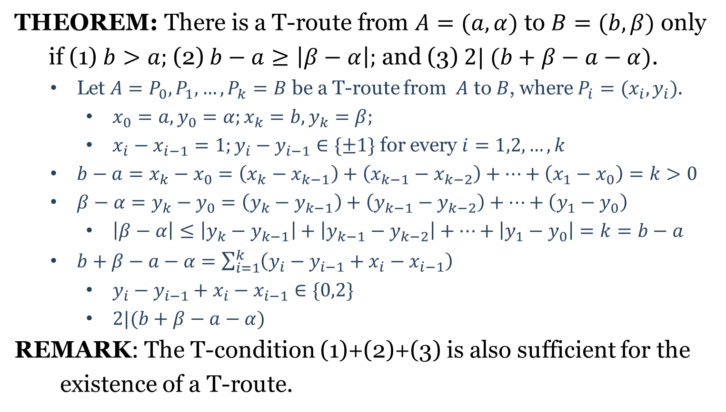
T-Route
THEOREM: There is a T-route from $A=(a,α)$ to $B=(b,β)$ only
if (1) $b>a;$(2) $b−a≥\left|β−α\right|;$ and (3) $2| (b+β−a−α)$.
Let $A=P_{0}, P_{1},…,P_{k}=B$ be a T-route from $A$ to $B$, where $P_{i}=(x_{i},y_{i})$.
$x_{0}=a, y_{0}=α;x_{k}=b, y_{k}=β;$
$x_{i}−x_{i−1}=1;y_{i}−y_{i−1}∈\{±1\}$ for every $i=1,2,…,k$
$b−a=x_{k}−x_{0}=\left(x_{k}−x_{k−1}\right)+\left(x_{k−1}−x_{k−2}\right)+⋯+\left(x_{1}−x_{0}\right)=k>0$
$β−α=y_{k}−y_{0}=\left(y_{k}−y_{k−1}\right)+\left(y_{k−1}−y_{k−2}\right)+⋯+\left(y_{1}−y_{0}\right)$
$\left|β−α\right|≤\left|y_{k}−y_{k−1}\right|+\left|y_{k−1}−y_{k−2}\right|+⋯+\left|y_{1}−y_{0}\right|=k=b−a$
$b+β−a−α=\sum_{i=1}^{k}{\left(y_{i}−y_{i−1}+x_{i}−x_{i−1}\right)}$
$y_{i}−y_{i−1}+x_{i}−x_{i−1}∈\{0,2\}$
$2|(b+β−a−α)$
REMARK: The T-condition (1)+(2)+(3) is also sufficient for the
existence of a T-route.

Slide 3
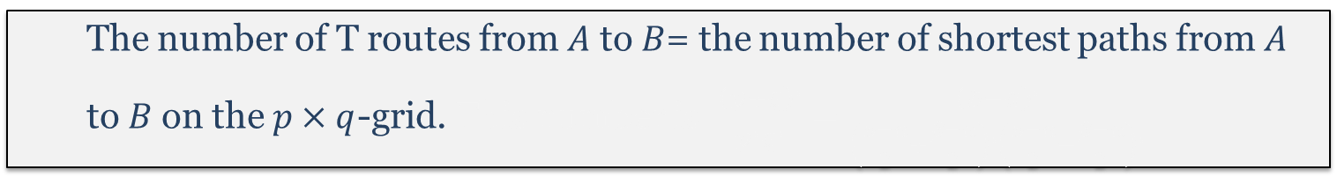
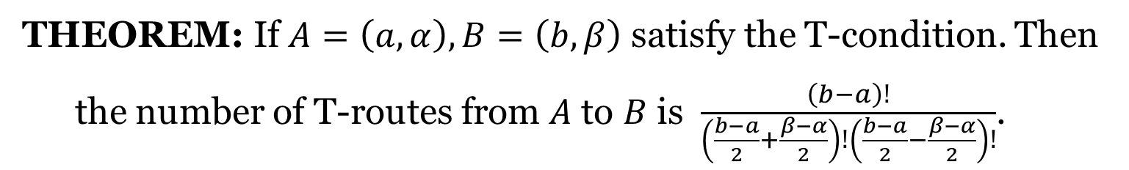




Number of T-Routes
THEOREM: If $A=\left(a,α\right),B=\left(b,β\right)$ satisfy the T-condition. Then
the number of T-routes from $A$ to $B$ is $\frac{\left(b−a\right)!}{\left(\frac{b−a}{2}+\frac{β−α}{2}\right)!\left(\frac{b−a}{2}−\frac{β−α}{2}\right)!}$.
$$D$$
$$B (b,β)$$
$$\left(a,α\right) A$$
The number of T routes from $A$ to $B$= the number of shortest paths from $A$ to $B$ on the $p×q$-grid. This number is $\frac{\left(p+q\right)!}{p!q!}=\frac{\left(b−a\right)!}{\left(\frac{b−a}{2}+\frac{β−α}{2}\right)!\left(\frac{b−a}{2}−\frac{β−α}{2}\right)!}$
$$C$$

Slide 4

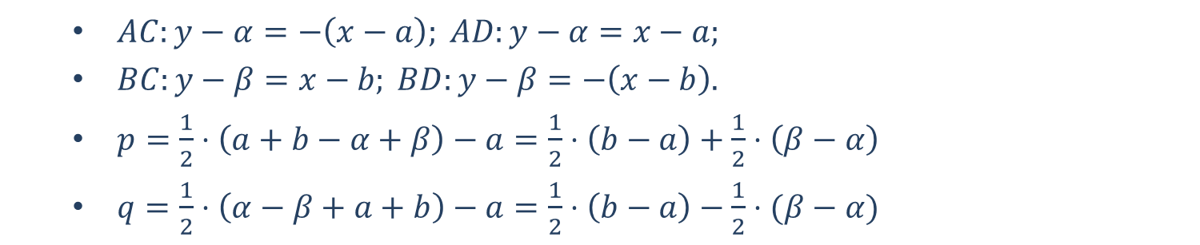

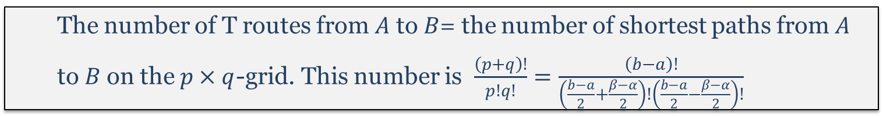






$AC:y−α=−\left(x−a\right); AD:y−α=x−a;$
$BC:y−β=x−b; BD:y−β=−\left(x−b\right).$
$p=\frac{1}{2}⋅\left(a+b−α+β\right)−a=\frac{1}{2}⋅\left(b−a\right)+\frac{1}{2}⋅\left(β−α\right)$
$q=\frac{1}{2}⋅\left(α−β+a+b\right)−a=\frac{1}{2}⋅\left(b−a\right)−\frac{1}{2}⋅(β−α)$
$$1/2⋅\left(a+b−α+β,α+β−a+b\right)$$
$$D$$
$p$ (steps)
$$B (b,β)$$
$$\left(a,α\right) A$$
The number of T routes from $A$ to $B$= the number of shortest paths from $A$ to $B$ on the $p×q$-grid. This number is $\frac{\left(p+q\right)!}{p!q!}=\frac{\left(b−a\right)!}{\left(\frac{b−a}{2}+\frac{β−α}{2}\right)!\left(\frac{b−a}{2}−\frac{β−α}{2}\right)!}$
$q$ (steps)
$$C$$
$$1/2⋅\left(α−β+a+b,a−b+α+β\right)$$

Slide 5

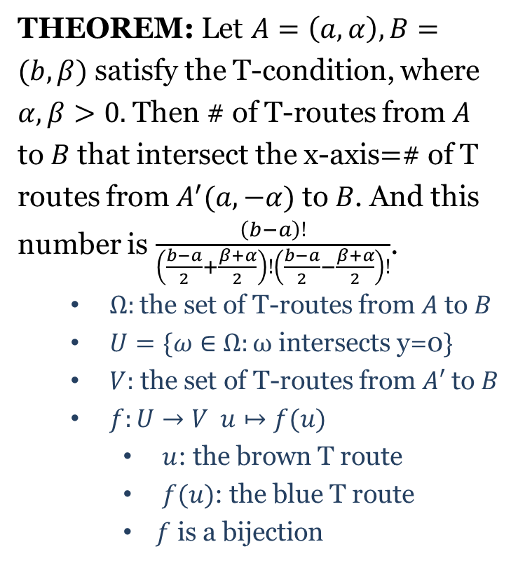




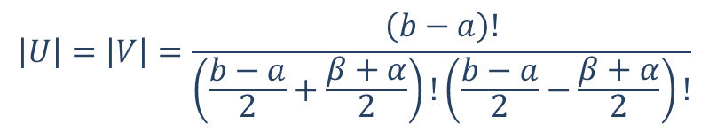
Number of T-Routes
$$D$$
THEOREM: Let $A=\left(a,α\right),B=(b,β)$ satisfy the T-condition, where $α,β>0.$ Then # of T-routes from $A$ to $B$ that intersect the x-axis$=$# of T routes from $A^{′}(a,−α)$ to $B$. And this
number is $\frac{\left(b−a\right)!}{\left(\frac{b−a}{2}+\frac{β+α}{2}\right)!\left(\frac{b−a}{2}−\frac{β+α}{2}\right)!}$.
$Ω:$ the set of T-routes from $A$ to $B$
$U=\{ω∈Ω:ω \text{intersect}\text{s} \text{y}\text{=0}\}$
$V:$ the set of T-routes from $A′$ to $B$
$f:U→V u↦f(u)$
$u$: the brown T route
$f(u)$: the blue T route
$f$ is a bijection
$$B (b,β)$$
$$\left(a,α\right) A$$
$$C$$
$$\left(a,−α\right) A^{′}$$
$$\left|U\right|=\left|V\right|=\frac{\left(b−a\right)!}{\left(\frac{b−a}{2}+\frac{β+α}{2}\right)!\left(\frac{b−a}{2}−\frac{β+α}{2}\right)!}$$

Slide 6
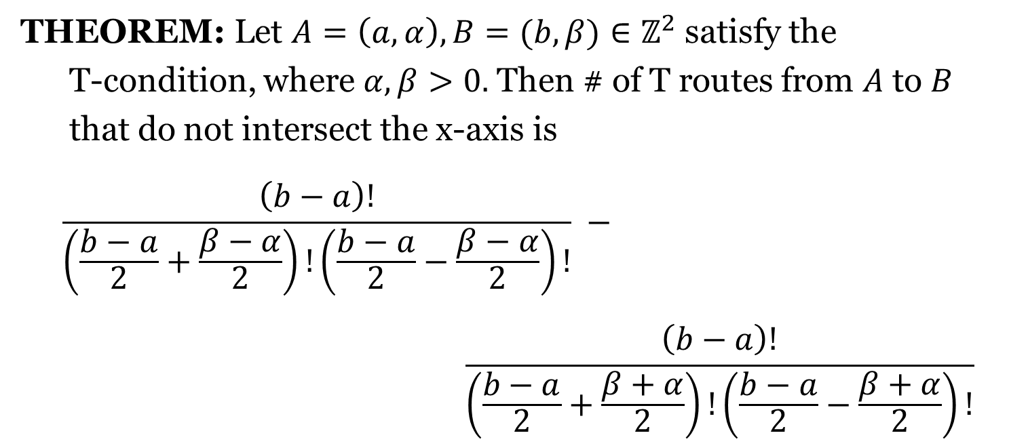
Number of T Routes
THEOREM: Let $A=\left(a,α\right),B=(b,β)∈ℤ^{2}$ satisfy the
T-condition, where $α,β>0.$ Then # of T routes from $A$ to $B$
that do not intersect the x-axis is
$$\frac{\left(b−a\right)!}{\left(\frac{b−a}{2}+\frac{β−α}{2}\right)!\left(\frac{b−a}{2}−\frac{β−α}{2}\right)!} −$$
$$\frac{\left(b−a\right)!}{\left(\frac{b−a}{2}+\frac{β+α}{2}\right)!\left(\frac{b−a}{2}−\frac{β+α}{2}\right)!}$$

Slide 7



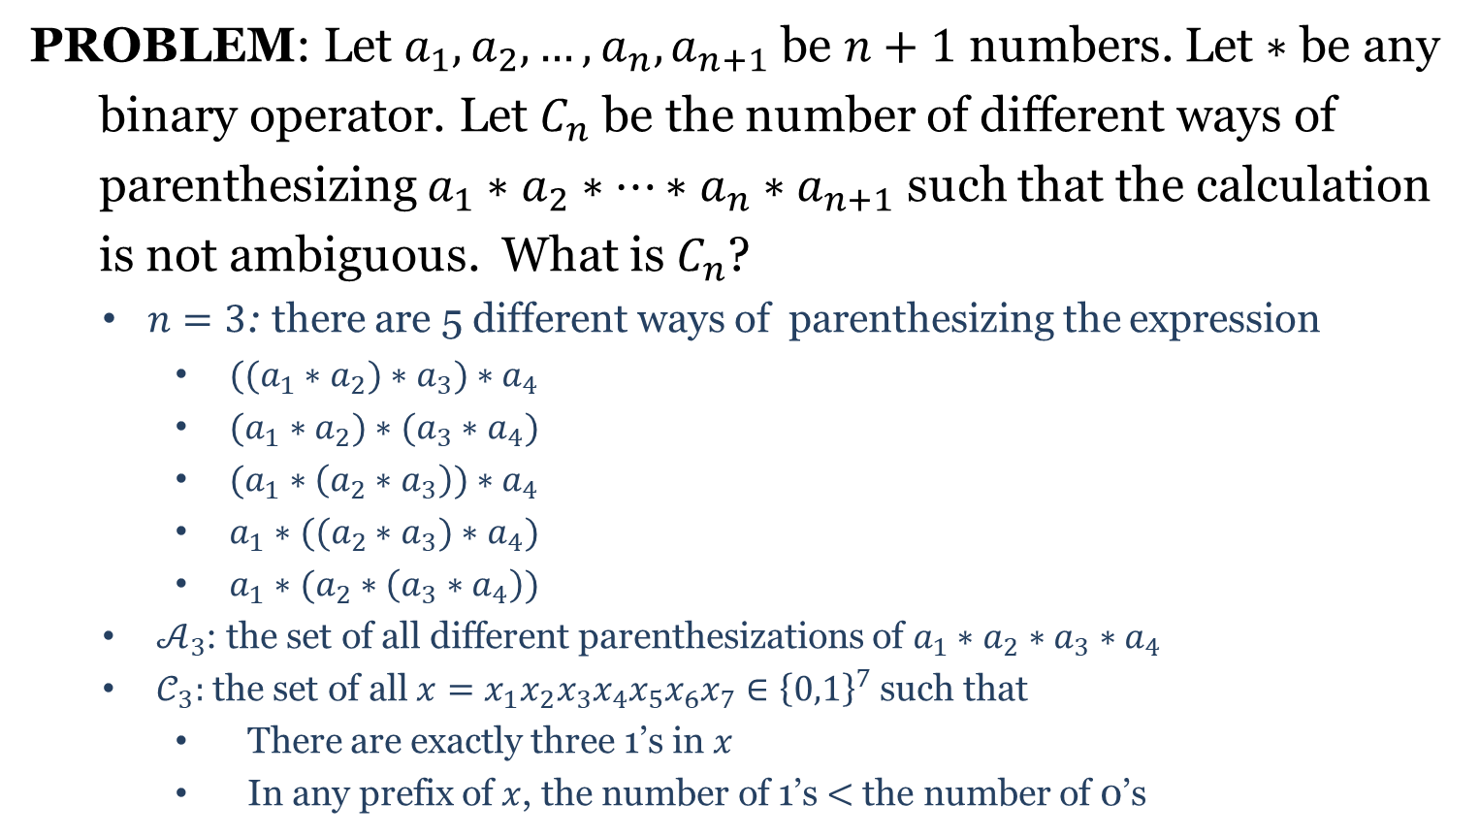












Parenthesization
PROBLEM: Let $a_{1},a_{2},…,a_{n},a_{n+1}$ be $n+1$ numbers. Let $∗$ be any
binary operator. Let $C_{n}$ be the number of different ways of
parenthesizing $a_{1}∗a_{2}∗⋯∗a_{n}∗a_{n+1}$ such that the calculation
is not ambiguous. What is $C_{n}$?
$n=3$: there are 5 different ways of parenthesizing the expression
$((a_{1}∗a_{2})∗a_{3})∗a_{4}$
$(a_{1}∗a_{2})∗(a_{3}∗a_{4})$
$(a_{1}∗\left(a_{2}∗a_{3}\right))∗a_{4}$
$a_{1}∗((a_{2}∗a_{3})∗a_{4})$
$a_{1}∗(a_{2}∗\left(a_{3}∗a_{4}\right))$
$𝒜_{3}$: the set of all different parenthesizations of $a_{1}∗a_{2}∗a_{3}∗a_{4}$
$𝒞_{3}:$ the set of all $x=x_{1}x_{2}x_{3}x_{4}x_{5}x_{6}x_{7}∈{\left\{0,1\right\}}^{7}$ such that
There are exactly three 1’s in $x$
In any prefix of $x$, the number of 1’s $<$ the number of 0’s
$$a_{1}↲a_{2}↲∗a_{3}↲∗a_{4}↲∗$$
$$↲↲∗↲∗↲∗$$
$$0010101$$
$$a_{1}↲a_{2}↲∗a_{3}↲a_{4}↲∗∗$$
$$↲↲∗↲↲∗∗$$
$$0010011$$
$$a_{1}↲a_{2}↲a_{3}↲∗ ∗a_{4}↲∗$$
$$↲↲↲∗∗↲∗$$
$$0001101$$
$$a_{1}↲a_{2}↲a_{3}↲∗a_{4}↲∗∗$$
$$↲↲↲∗↲∗∗$$
$$0001011$$
$$a_{1}↲a_{2}↲a_{3}↲a_{4}↲∗∗∗$$
$$↲↲↲↲∗∗∗$$
$$0000111$$

Slide 8
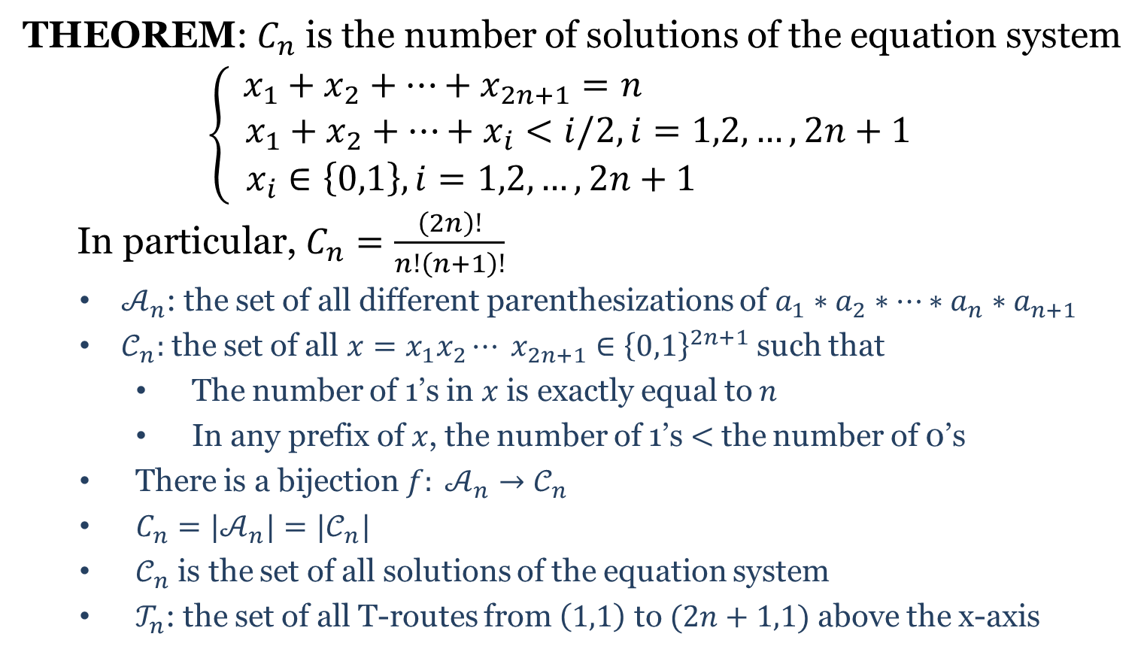
Parenthesization
THEOREM: $C_{n}$ is the number of solutions of the equation system
$$\left\{\begin{aligned} x_{1}+x_{2}+⋯+x_{2n+1}=n \\ x_{1}+x_{2}+⋯+x_{i}<i/2, i=1,2,…,2n+1 \\ x_{i}∈\left\{0,1\right\}, i=1,2,…,2n+1 \end{aligned} \right.$$
In particular, $C_{n}=\frac{\left(2n\right)!}{n!\left(n+1\right)!}$
$𝒜_{n}$: the set of all different parenthesizations of $a_{1}∗a_{2}∗⋯∗a_{n}∗a_{n+1}$
$𝒞_{n}:$ the set of all $x=x_{1}x_{2}⋯ x_{2n+1}∈{\left\{0,1\right\}}^{2n+1}$ such that
The number of 1’s in $x$ is exactly equal to $n$
In any prefix of $x$, the number of 1’s $<$ the number of 0’s
There is a bijection $f: 𝒜_{n}→𝒞_{n}$
$C_{n}=|𝒜_{n}|=|𝒞_{n}|$
$𝒞_{n}$ is the set of all solutions of the equation system
$𝒯_{n}$: the set of all T-routes from $\left(1,1\right)$ to $(2n+1,1)$ above the x-axis

Slide 9
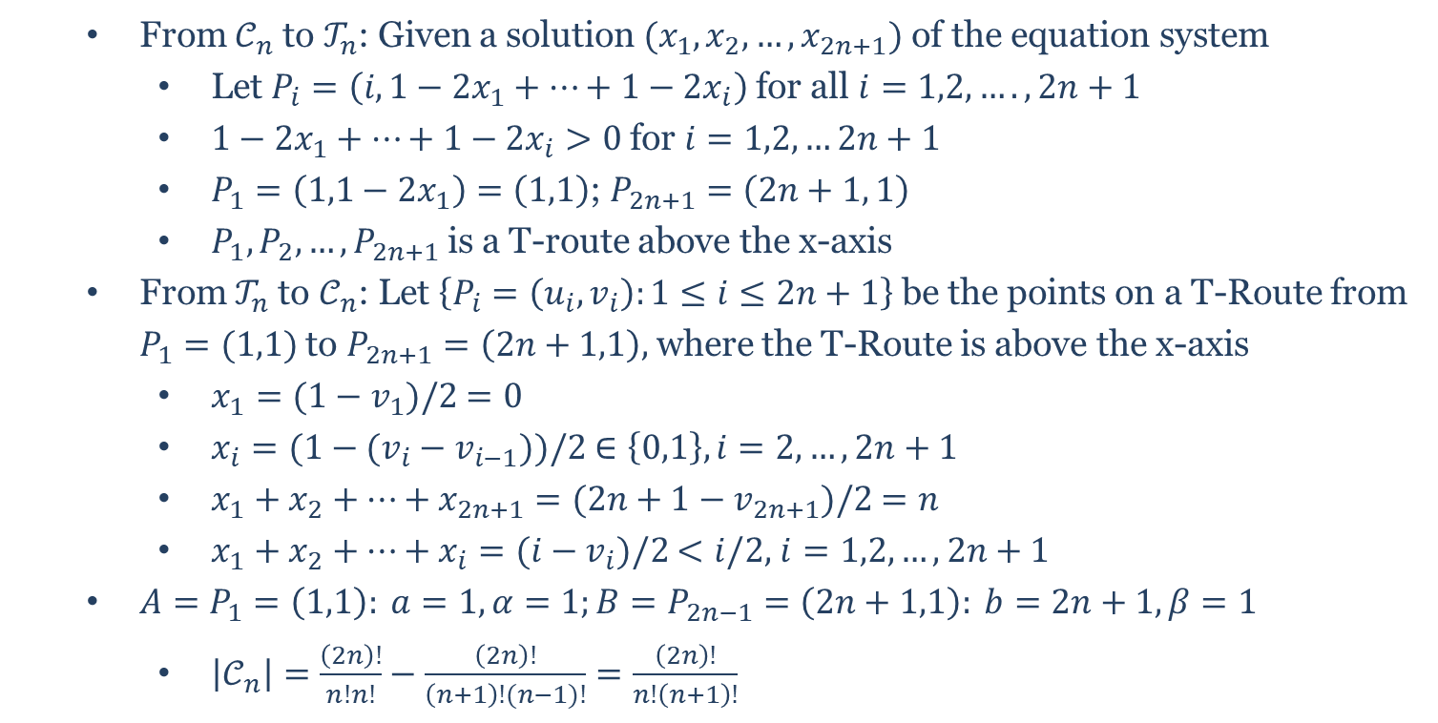
Parenthesization
From $𝒞_{n}$ to $𝒯_{n}$: Given a solution $(x_{1},x_{2},…,x_{2n+1})$ of the equation system
Let $P_{i}=\left(i,1−2x_{1}+⋯+1−2x_{i}\right)$ for all $i=1,2,….,2n+1$
$1−2x_{1}+⋯+1−2x_{i}>0$ for $i=1,2,…2n+1$
$P_{1}=\left(1,1−2x_{1}\right)=\left(1,1\right)$; $P_{2n+1}=\left(2n+1, 1\right)$
$P_{1},P_{2},…,P_{2n+1}$ is a T-route above the x-axis
From $𝒯_{n}$ to $𝒞_{n}$: Let $\left\{P_{i}=\left(u_{i},v_{i}\right):1≤i≤2n+1\right\}$ be the points on a T-Route from $P_{1}=(1,1)$ to $P_{2n+1}=\left(2n+1,1\right),$ where the T-Route is above the x-axis
$x_{1}=(1−v_{1})/2$ $=0$
$x_{i}=(1−(v_{i}−v_{i−1}))/2$ $∈\left\{0,1\right\}, i=2,…,2n+1$
$x_{1}+x_{2}+…+x_{2n+1}=(2n+1−v_{2n+1})/2$ $=n$
$x_{1}+x_{2}+…+x_{i}=(i−v_{i})/2$ $<i/2,$ $i=1,2,…,2n+1$
$A=P_{1}=\left(1,1\right): a=1, α=1;B=P_{2n−1}=\left(2n+1,1\right): b=2n+1, β=1$
$\left|𝒞_{n}\right|=\frac{\left(2n\right)!}{n!n!}−\frac{\left(2n\right)!}{\left(n+1\right)!(n−1)!}=\frac{\left(2n\right)!}{n!\left(n+1\right)!}$

